Slide 1
CS 380 Presentation
Game AI for Turn Based Strategy Games

Slide 2
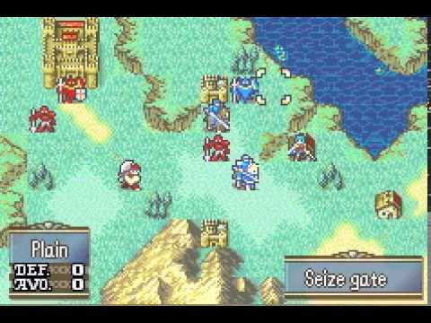
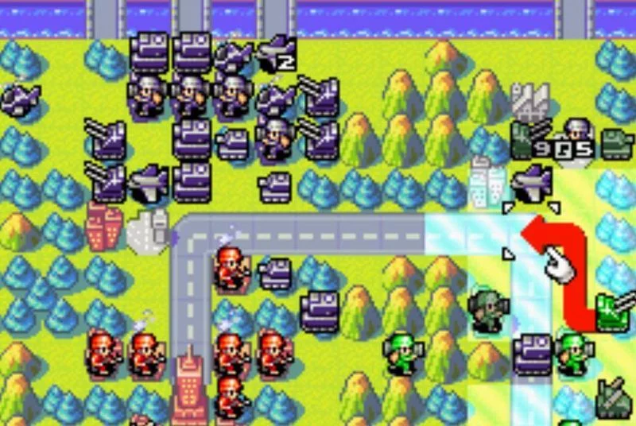
Problem: Stupid/Simple AI
Main Contenders: Fire Emblem and Advance Wars

Slide 3
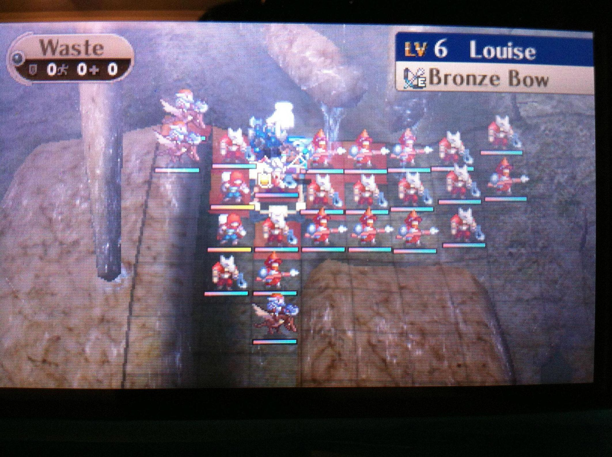
Problem: Stupid/Simple AI
AI prioritizes damage above everything
If there is a faraway enemy that can receive damage, or a near enemy that is immune to the damage, it will attack the latter.
How to make it harder? Increase stats and put more enemies
But that just makes it unfair and tedious

Slide 4
My Solution
Two level system
Strategic AI
Chooses the best course of action
Enemy AI
Calculates its own best course of action called Choice
Utility Score System
A score is calculated for each possible Choice
Score is determined from 7 different values
Tile Bonus
Enemy Influence
Ally Influence
Nearest Enemy
Fight Weight
Damage Weight
Kill Weight

Slide 5
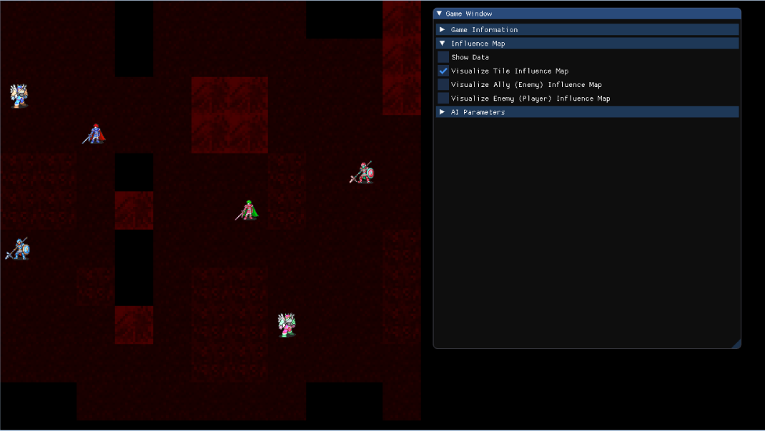
Tile Bonus

Slide 6
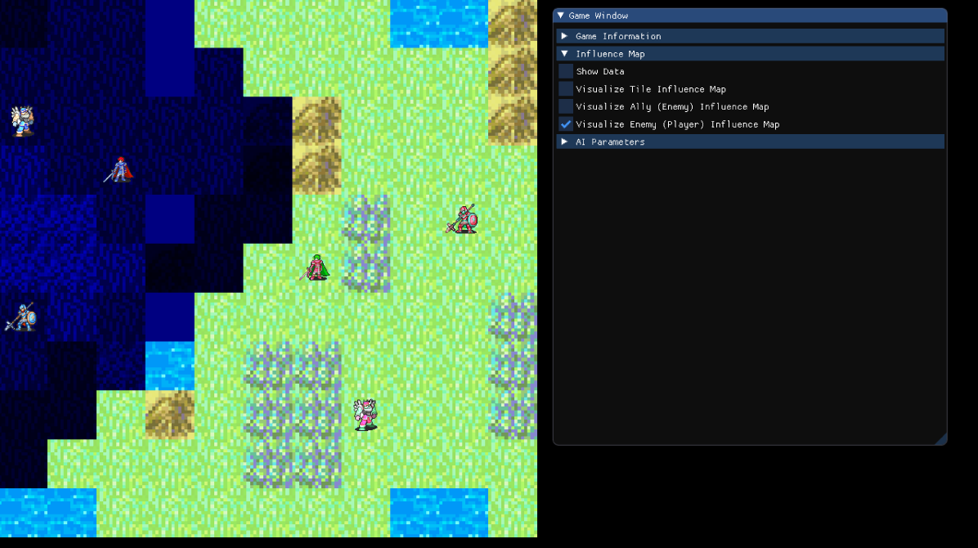
Enemy Influence

Slide 7
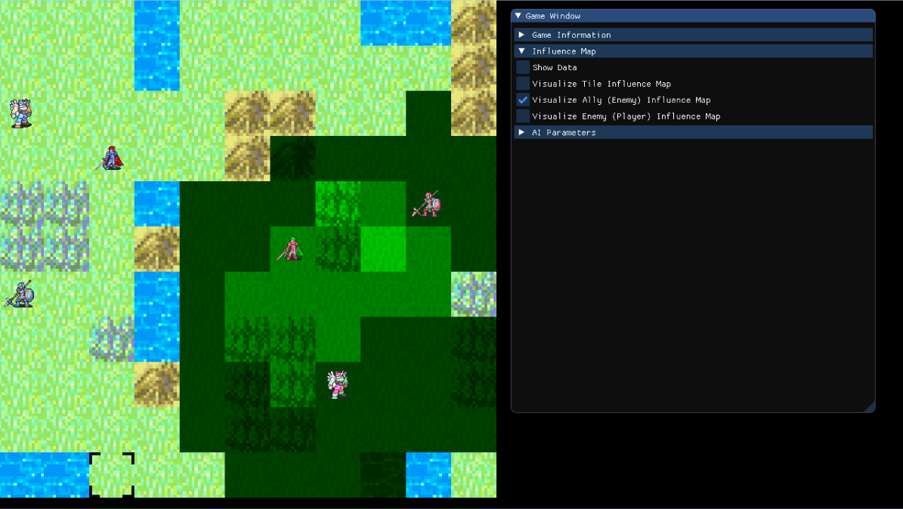
Ally Influence

Slide 8
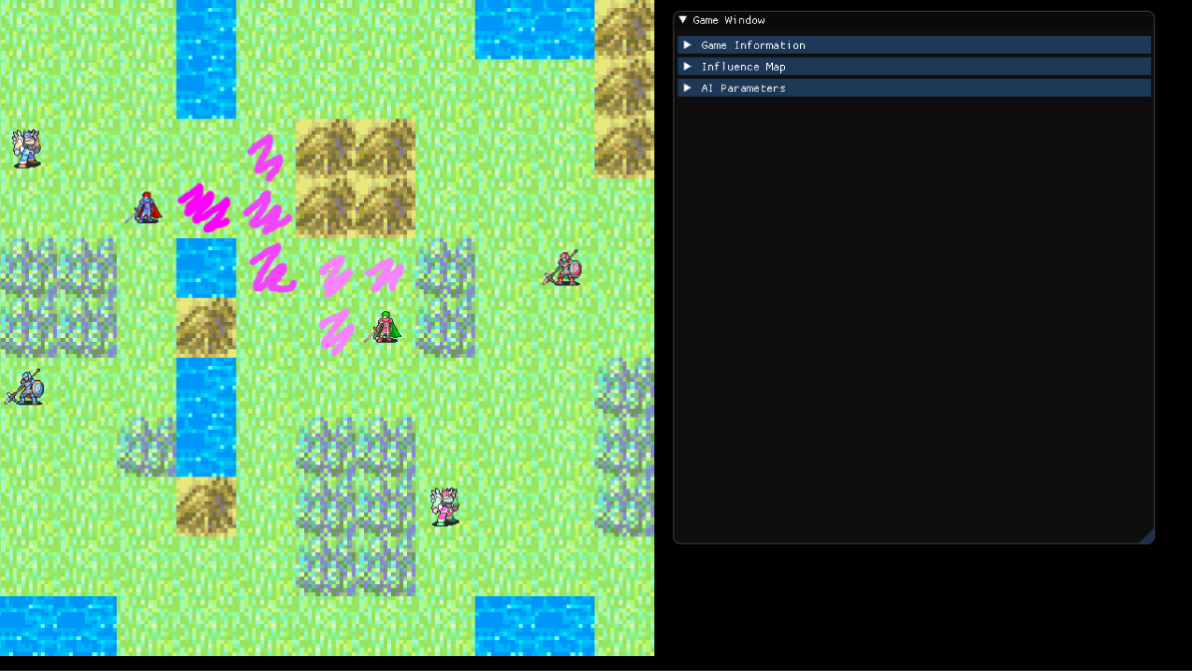
Nearest Enemy

Slide 9
Fight Weight
Fight Score = Weight
Basically used to make the AI prioritize fighting or ignore it

Slide 10
Combat Weight
Combat Score = Max(Damage - (Armor + Bonus), 1) * Weight
Combat Score = Total Possible Damage * Weight

Slide 11
Kill Weight
Kill Score = 1 / Health * Weight
The Lower the Health, the more priority it takes

Slide 12
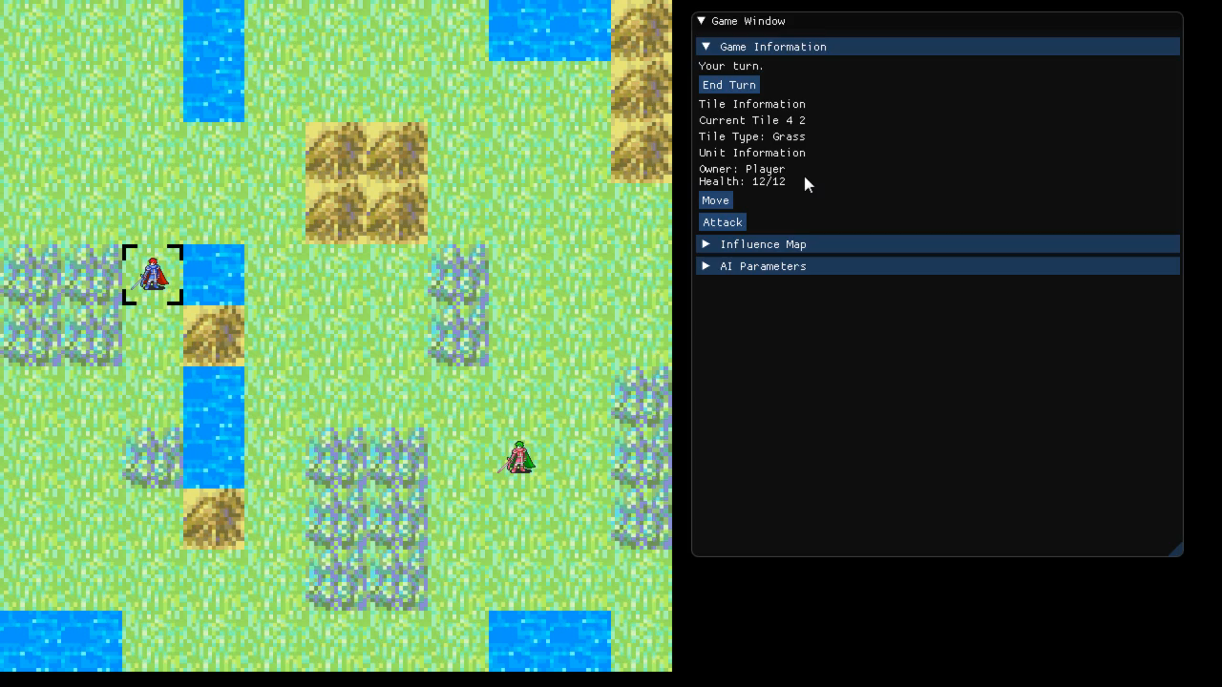
Personality Example “Default”
Tile Bonus = 1
Enemy Influence = 1
Ally Influence = 1
Nearest Enemy = 1
Fight Weight = 1
Combat Weight = 1
Kill Weight = 1

Slide 13
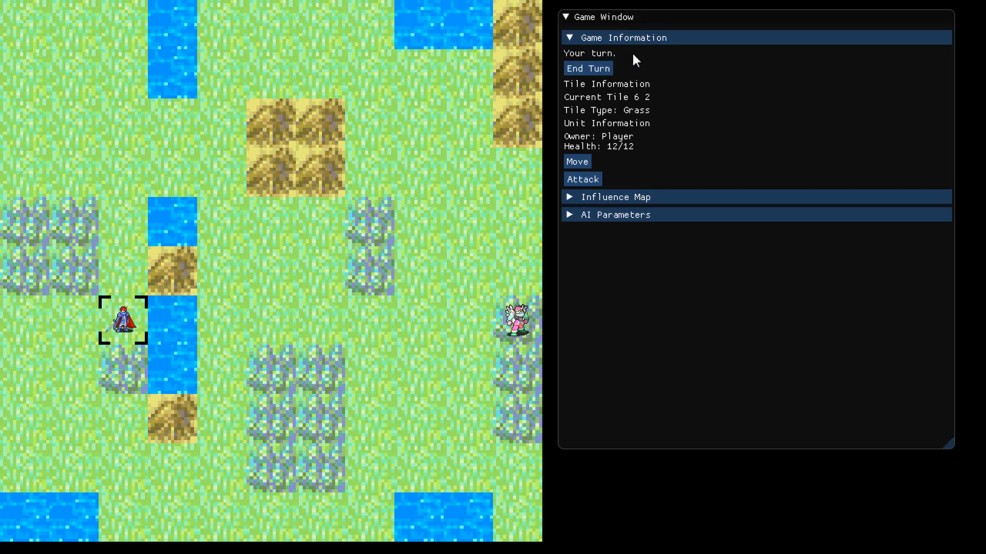
Personality Example “Aggressive”
Tile Bonus = 0 (1 for Smart)
Enemy Influence = 0
Ally Influence = 0
Nearest Enemy = 5
Fight Weight = 5
Combat Weight = 1
Kill Weight = 1

Slide 14
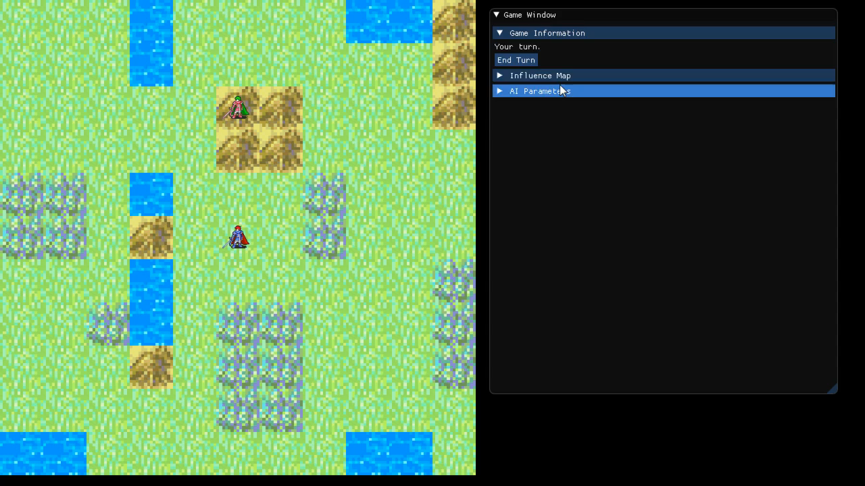
Personality Example “Defensive”
Tile Bonus = 20
Enemy Influence = 1
Ally Influence = 1
Nearest Enemy = 0.5
Fight Weight = 1
Combat Weight = 1
Kill Weight = 1

Slide 15
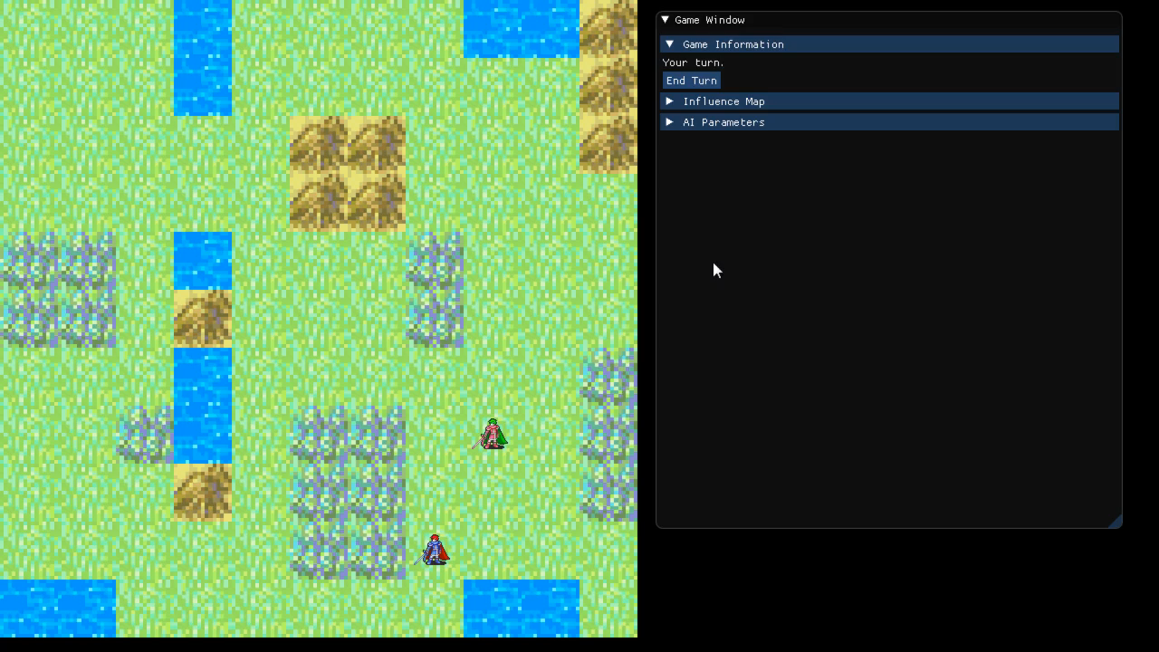
Personality Example “Coward”
Tile Bonus = 1 (0 for Stupid)
Enemy Influence = 1
Ally Influence = 1
Nearest Enemy = -1
Fight Weight = -1
Combat Weight = -1
Kill Weight = -1

